Slide 1

SURVEY OF BEST CITIES BASED ON HOTEL RECOMMENDATIONS

Slide 2

SUMMARY OF DATA ANALYSIS
DATA INDICATES THAT HOTEL USERS ARE NOT TOO KEEN ON FULL-BOARD, BUT WOULD RATHER EAT OUT AS THEY VISIT THE TOWN.

Slide 3
Data collected based on survey of over 200 hotels per country
INDEX_COL | COUNTRY | FEEDBACK_10 | RATING_ 5 | WITH_BOARD_PER_20_HOTELS | POPULAR_CITY
fra | France | 7 | 4 | 15 | paris
usa | United States | 8 | 4 | 14 | arizona
spa | Spain | 9 | 4 | 16 | alhambra
chi | China | 7 | 3 | 9 | beijing
ita | Italy | 6 | 3 | 8 | rome
uk | United Kingdom | 7 | 4 | 10 | london
ger | Germany | 8 | 5 | 8 | berlin
mex | Mexico | 8 | 4 | 10 | durango
tha | Thailand | 8 | 4 | 13 | bangkok
tur | Turkey | 7 | 2 | 8 | istanbul
aus | Austria | 6 | 3 | 9 | hallstatt
mal | Malaysia | 8 | 5 | 12 | mulu
hkg | Hong Kong | 8 | 4 | 7 | kowloon
gre | Greece | 9 | 5 | 13 | santorini
rus | Russia | 6 | 2 | 6 | moscow

Slide 4
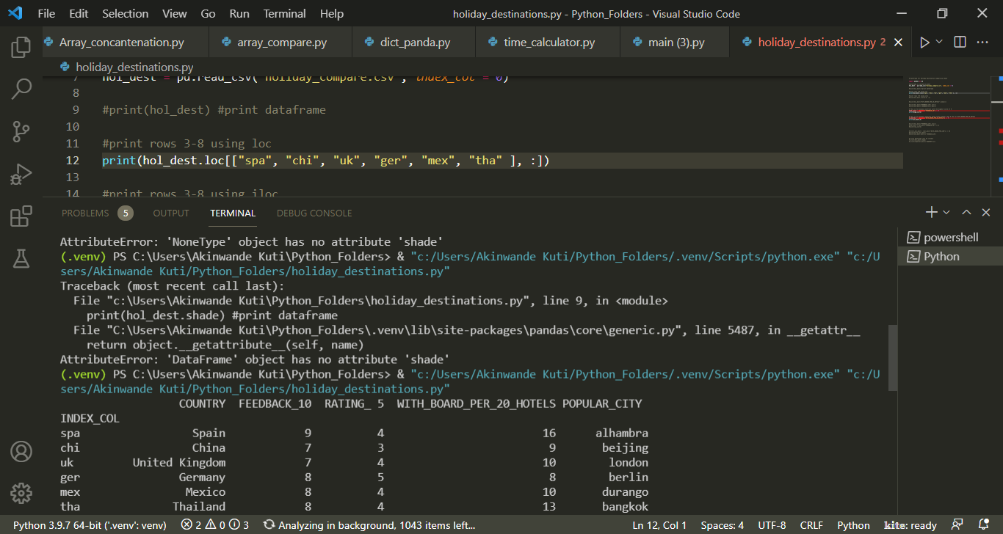
Print-out for Row 3-8 using loc

Slide 5
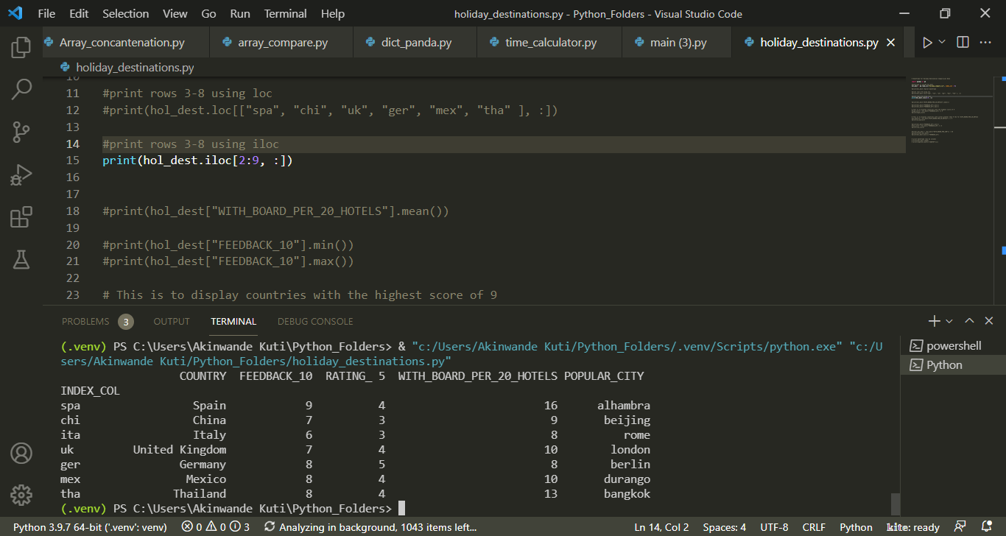
Print-out for Row 3-8 using iloc

Slide 6
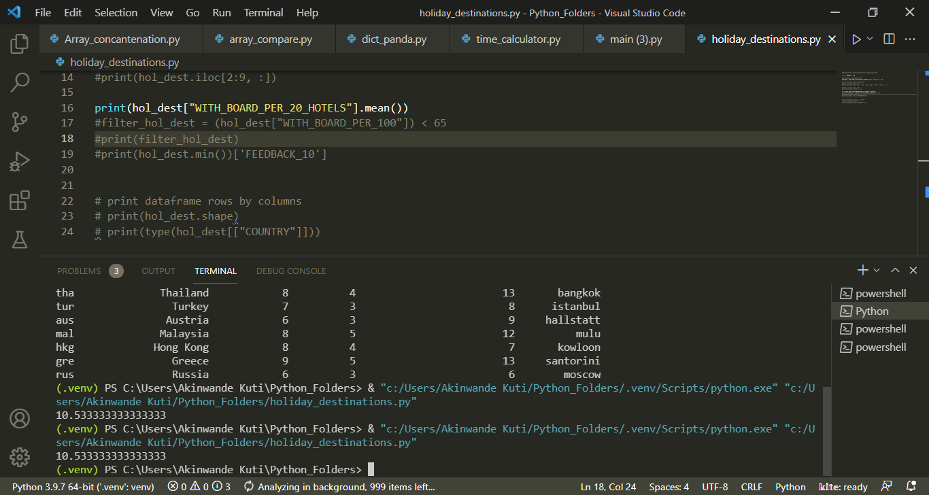
Display of Mean Number For All_Inclusive Hotels

Slide 7
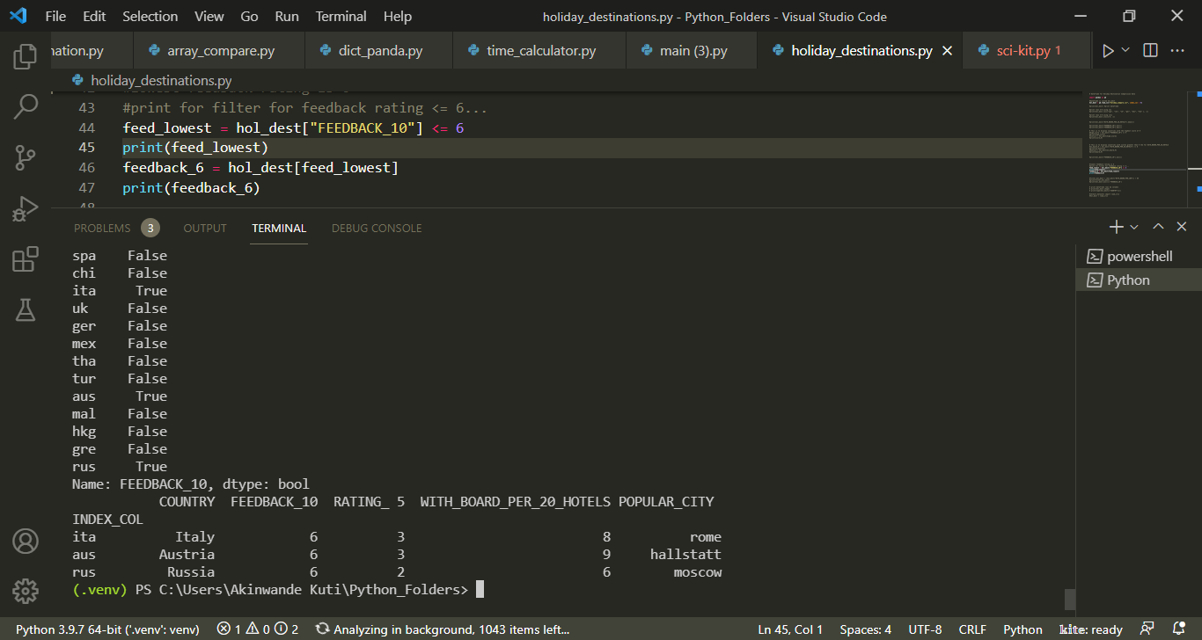
Lowest scoring destination Analysis. Lowest Score = 6

Slide 8
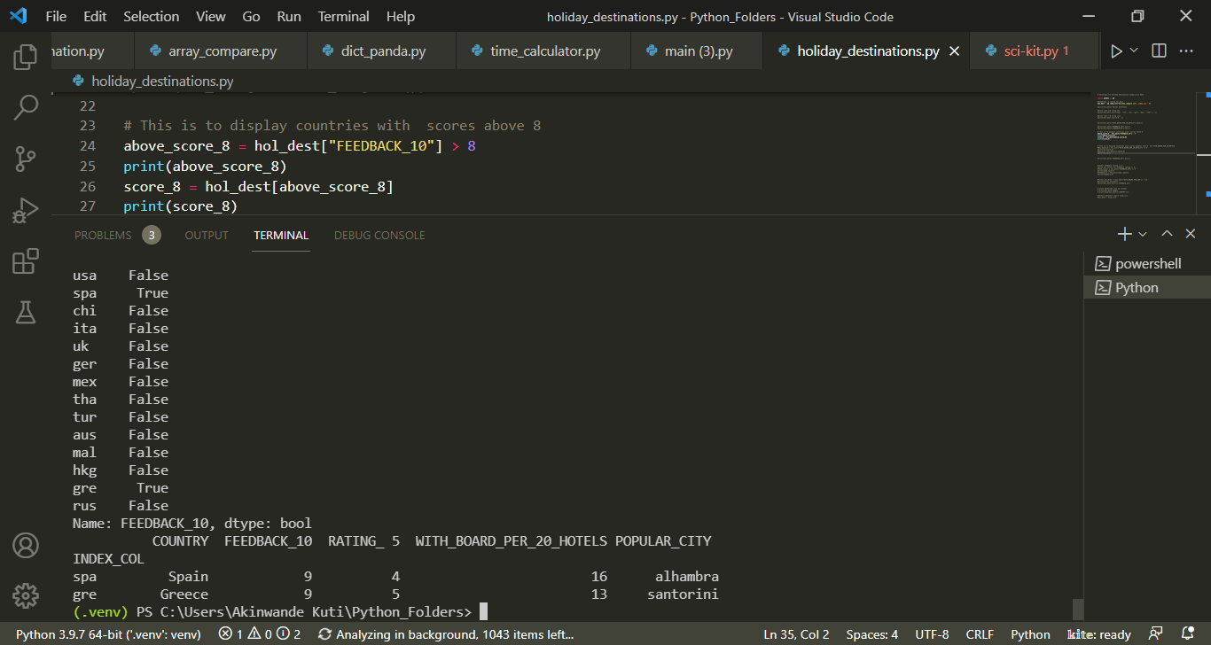
Highest Scoring Destination. Score = 9.

Slide 9
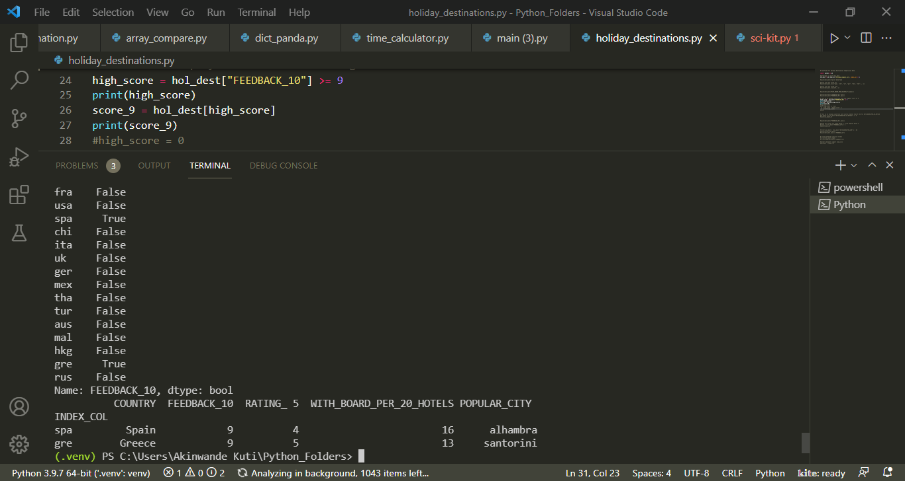
All Inclusive hotels with score > 9

Slide 10
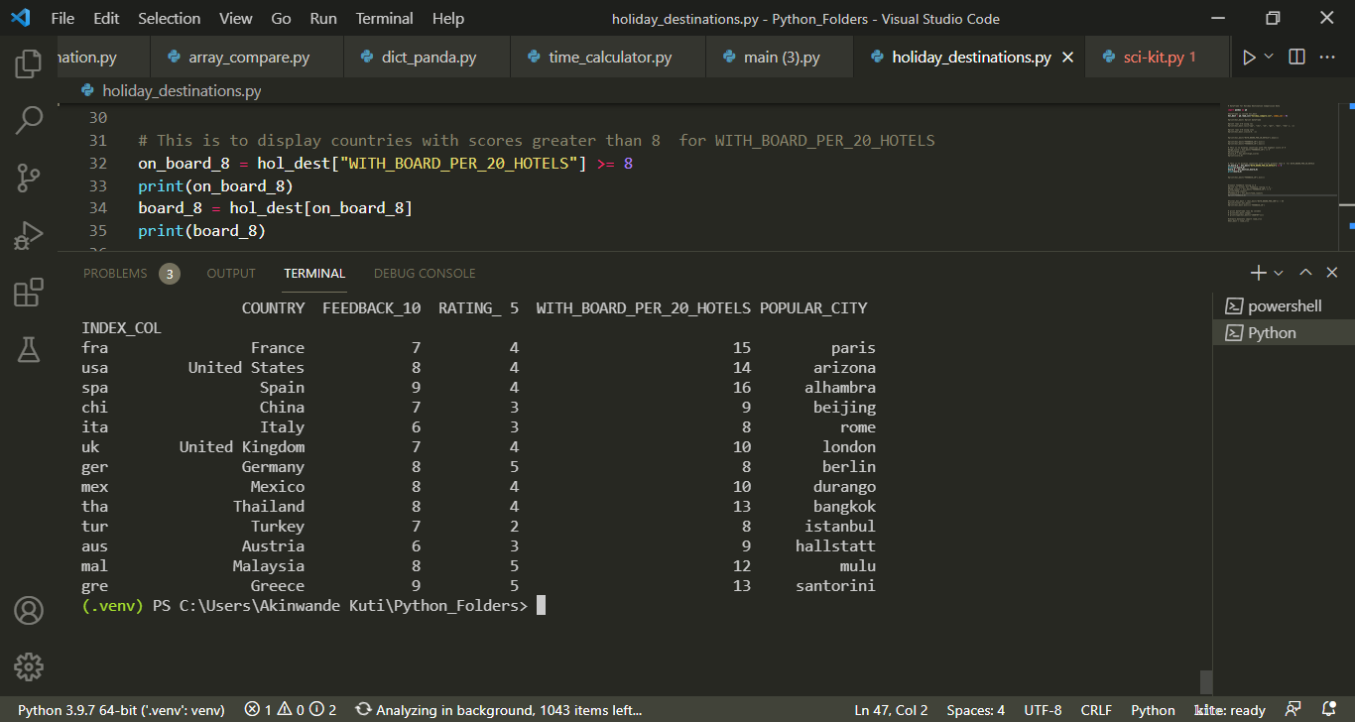
Score of above 8 for All-Inclusive Hotels

Slide 11
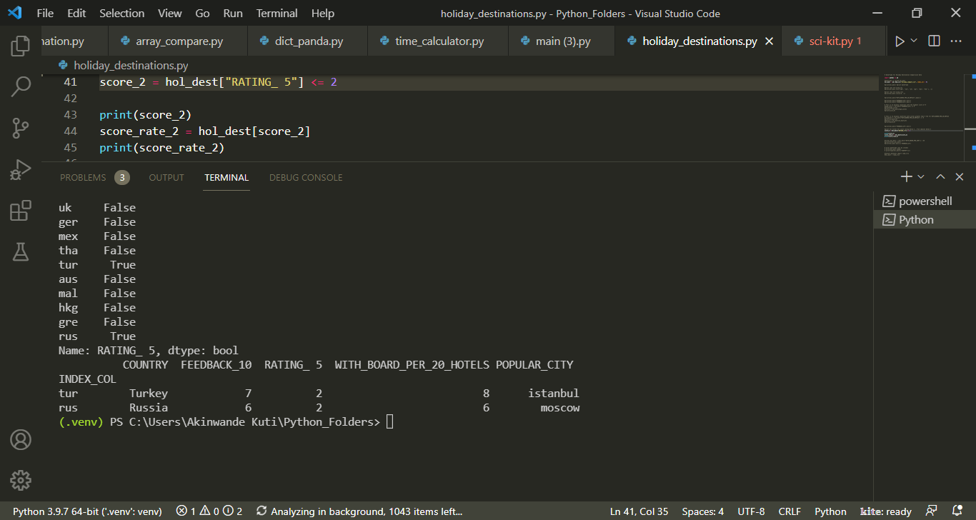
Score below 2 for survey

Slide 12
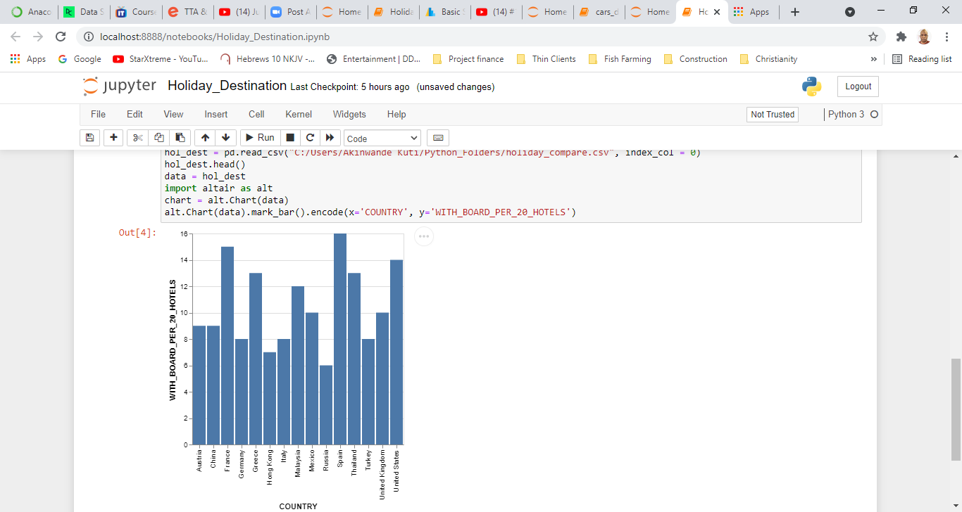
Histogram of Country Vs Boarding Rating

Slide 13
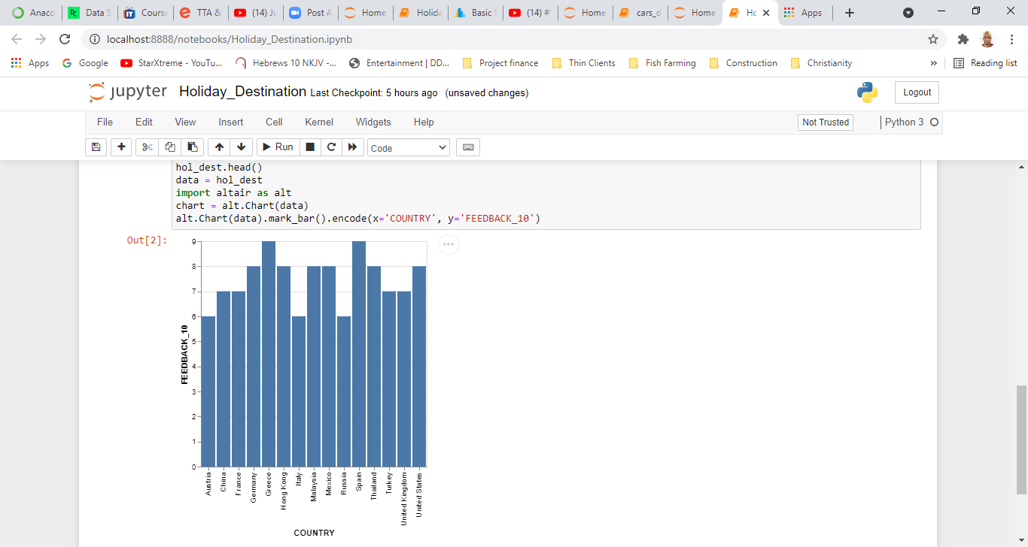
Histogram: Country Vs Feedback Rating

Slide 14
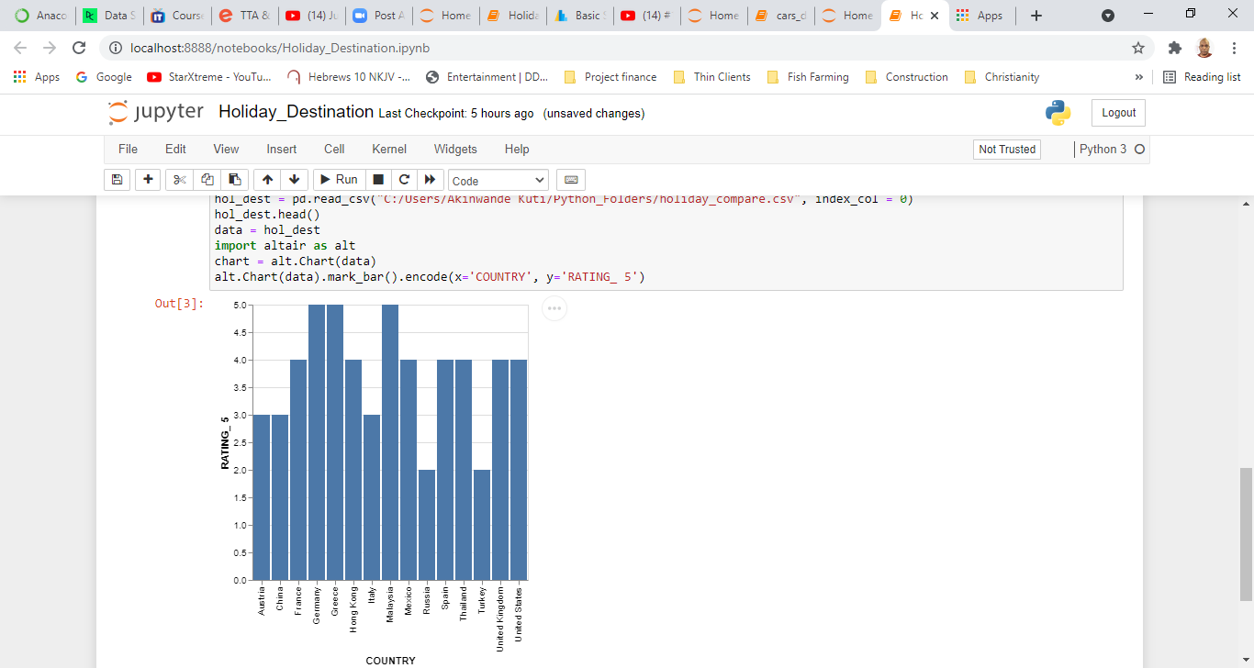
Histogram: Country Vs Rating

